Slide 1
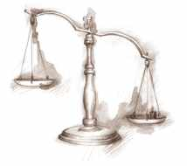
The Treaty of Versailles
How and why did the ‘Big Three’ want to punish Germany?

Slide 2
Topic: The Treaty of Versailles
Learning Intention: Describe the significance of the Treaty of Versailles. Success Criteria: I can outline what the Treaty of Versailles was I can list the key people/countries involved and provide an example of what they wanted to achieve I can list 5 terms of the Treaty I can provide a suggestion on how the Treaty caused WWII
Agenda: 2. Note taking 3. Discussion regarding the Treaty of Versailles 4. Review | Vocabulary: Treaty, revenge, armistice, reparations, territory
Review: How would the German people have reacted to the Treaty of Versailles?

Slide 3
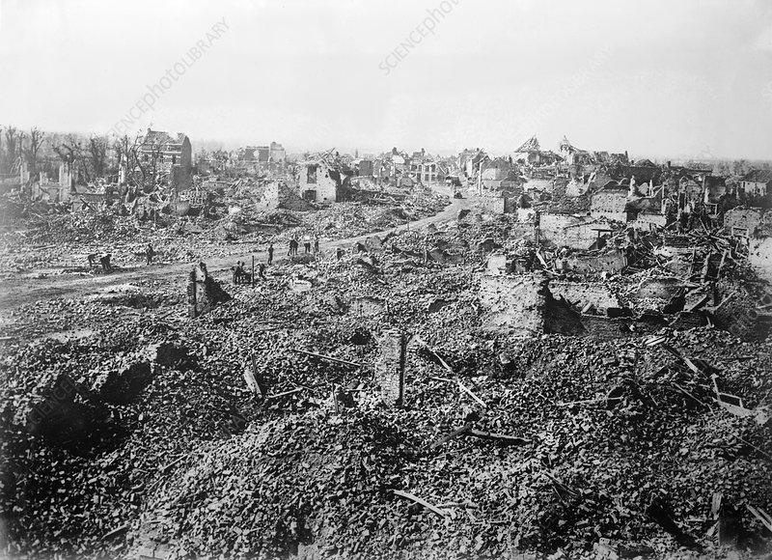
Results of WWI
WWI lasted from 1914 to the 11th November 1918 when the German government accepted an armistice (ceasefire). It was the most destructive war that the world had ever seen.
Approximately 16 million deaths – 5 million Allied troops died, with around 13 million wounded.
Extensive destruction of infrastructure, particularly in France
There was a great deal of anger in 1919, and many wanted revenge for all that had been lost.

Slide 4
Does this information help you to understand why so many people wanted revenge after the war?
Around 8 million people had been killed
The cost of the war was roughly nine thousand million pounds
The destruction of land, homes, farms and factories was huge
Millions more people died after the war due to famine and disease
“In France and Belgium, where most of the war was fought, 300,000 houses, 6,000 factories, 1,000 miles of railway, 2,000 breweries and 112 coal mines were destroyed…In some ways, mankind has never recovered from the horrors of the First World War.”
John D. Clare, First World War (1994)
Does this information help you to understand why so many people wanted Peace after the war?

Slide 5
What was the Treaty of Versailles?
The TOV is a peace treaty between Germany and members of the Triple Entente that was signed on the 28th June, 1919.
It was signed at the Palace of Versailles in France
The most powerful nations represented were Britain, France, the USA. Germany was not included in the negotiations.
Germany was the target of the treaty, the terms were designed to punish Germany and make it weak so that it couldn’t start another war

Slide 6
Summary Videos
https://www.youtube.com/watch?v=vrYhLNQMRro\
https://www.youtube.com/watch?v=0jycVFL8CNM

Slide 7



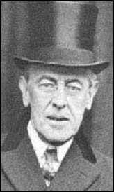
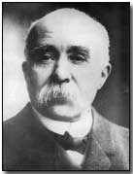
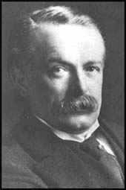
Great Britain, America and France were the three most powerful Allies and they wanted to exert their influence upon the Treaty of Versailles.
Yet they wanted different things.
Click on the individuals to find out what each wanted from the peace treaty
Once you have viewed each
On to exercise

Slide 8



Treaty Of Versailles
Leaders | Wanted | Did not want
David Lloyd George
Woodrow Wilson
George Clemenceau

Slide 9
Lloyd George (UK)
Germany to be justly punished, but not too harshly
Germany to lose its navy and colonies as these were a threat to Britain's own navy and empire
Germany and Britain to become trading partners
Click on the bulb to find out more
BUT Overall, Lloyd George did not want to punish Germany too harshly as he did not want Germany seeking revenge in the future

Slide 10
Lloyd George (UK)
There was pressure at home to make Germany pay – if he had been too soft he would have been voted out as PM. Lloyd George hated the Treaty. However "Hang the Kaiser" and "Make Germany Pay" were two very common calls in the era immediately after the end of the war and Lloyd George, looking for public support, echoed these views.
He liked the fact that Britain got German colonies, and the small German navy helped British sea-power. But, although many British people wanted to ‘make Germany pay’, Lloyd George thought that the Treaty was too harsh, and that it would start another war in 25 years time.
What did Lloyd George like and dislike about the Treaty?

Slide 11
Clemenceau (France)
to cripple Germany so it couldn't attack France again.
Wanted Germany broken down into smaller states (weakened).
France had suffered the most during the war so Clemenceau was under great pressure from the French people to make Germany pay.
Click on the bulb to find out more

Slide 12
Clemenceau (France)
Clemenceau liked the harsh things that were in the Treaty, especially reparations, because they would weaken Germany while helping France to recover. He had one very simple belief - Germany should be brought to its knees so that she could never start a war again (France had been invaded by Germany before in 1871).
He liked the idea of a small German army, and the demilitarised zone in the Rhineland, because he thought that this would protect France from attack in the future. Also, he was pleased that France received Alsace-Lorraine as this had been taken off France by Germany in 1871. In truth though, he wanted the Treaty to be harsher.
What did Clemenceau like and dislike about the Treaty?

Slide 13
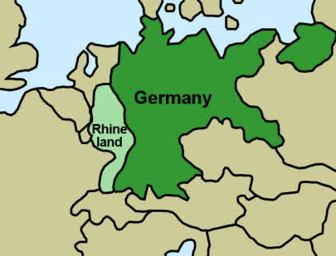

Slide 14
Wilson (USA)
a better and more peaceful world
a League of Nations that would help and support each other and help to promote world peace
the right to self-determination. The right to decide which country you wish to be governed by
The U.S.A. had joined war late (1917) and hadn't suffered as much as the other Allies in terms of human and material costs.
Click on the bulb to find out more

Slide 15
Wilson (USA)
Wilson got self-determination for the peoples of Eastern Europe, and a League of Nations, but he was disappointed with the Treaty because few of his ‘Fourteen Points’ were acted upon.
Worst of all, when Wilson went back to America, the Senate refused to join the League of Nations, and refused to sign the Treaty of Versailles! In America, there was a growing desire for the government to adopt a policy of isolation and leave Europe to its own devices. Wilson believed that Germany should be punished, but in a way that would lead to European reconciliation (peace) as opposed to revenge (war).
What did Wilson like and dislike about the treaty?

Slide 16
Treaty Of Versailles
Leaders | Wanted | Did not want
David Lloyd George
Woodrow Wilson
George Clemenceau

Slide 17
The terms of
The Treaty of Versailles
What would members of the public in Allied countries think of the Germans in 1918?

Slide 18

Germany had to accept total responsibility for starting the First World War.
this was called the War Guilt Clause or Article 231.

Slide 19


Germany had to pay £6,600 million in reparations to cover war damages and other Allied losses.
These were called reparations.

Slide 20
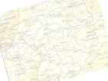

Germany had to hand over some 70,000 square kilometres of land.
This accounted for about 13% of all of her land and six million of her people who lived there.

Slide 21

Germany was to have her colonies taken away from her.
These colonies were to become mandates run by the Allies on behalf of the League of Nations.

Slide 22


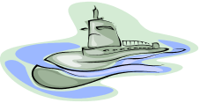
The German army was to have no more than 100,000 men and the navy was limited to 15,000 sailors.
There was to be no airforce and no submarines.

Slide 23
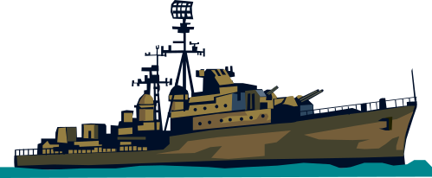
The German navy was only allowed six battleships and Germany was forbidden to buy any more weapons and other war material.

Slide 24

An Allied Army was to occupy the Rhineland for a period
of fifteen years.
No German troops were to be allowed into the occupation zone.
You now need to complete the card sorting activity on the terms of the Treaty of Versailles

Slide 25
Terms of the treaty of versailles | Damage Germany economically | Damage Germany militarily | Damage Germany’s pride
70,000 sq km of land was taken away from Germany No overseas colonies
Germany’s army was reduced to 100,000 men
She was not allowed an air force
She was allowed only 6 battleships and no submarines
Allied troops to occupy the Rhineland at all times
Germany had to accept full responsibility for starting the war.
Germany had to pay £6,600 million in reparations
http://www.dailymail.co.uk/news/article-1315869/Germany-end-World-War-One-reparations-92-years-59m-final-payment.html

Slide 26
The terms of
The Treaty of Versailles
How would the German people have felt about the terms of the Treaty?

Slide 27
German reactions to the Treaty
At first, the German government refused to sign the treaty as they thought it was too harsh, but had little choice in doing so.
Many Germans felt that the treaty was too severe and were humiliated by the terms
The huge war reparations meant that their economy suffered
Extreme groups, such as the Nazi Party, promised they would make Germany a stronger nation and help to rebuild it

Slide 28





Question: Describe the reaction of the German people to the Treaty of Versailles?

